Slide 1


Haptic display for a wearable human-robot interface
Semester project, final presentation
Student : Hugo Kohli Professor : Dario Floreano First assistant : Matteo Macchini Second assistant : Carine Rognon

Slide 2





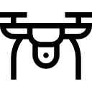
Motivations
1
Introduction
Integrate haptic guidance for a drone
2
Development
Tactile information
transmitted
to the pilot
Reduce drones trajectory error
3
Experimental work

Slide 3
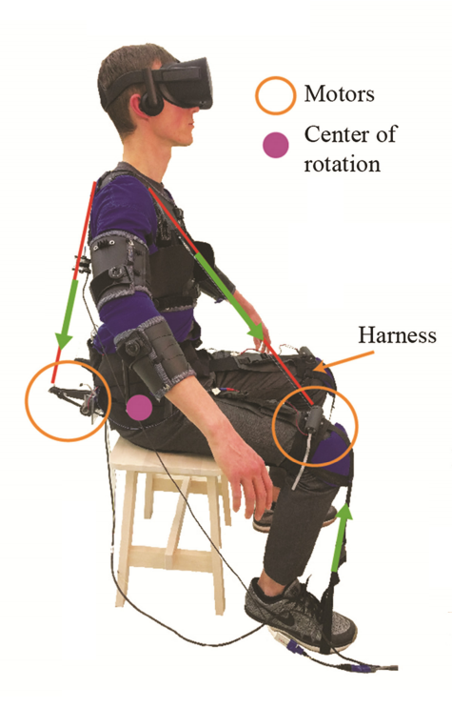
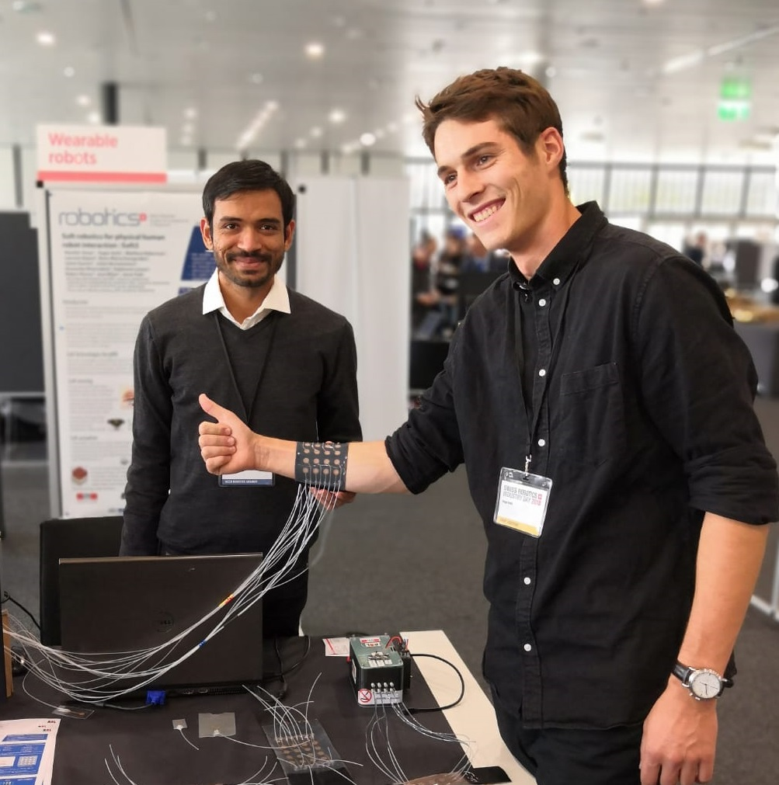
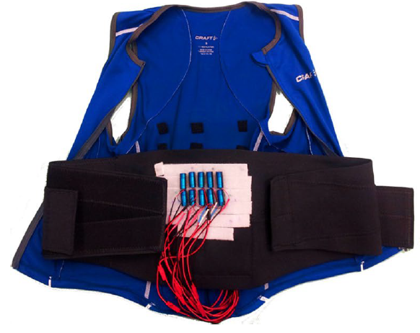
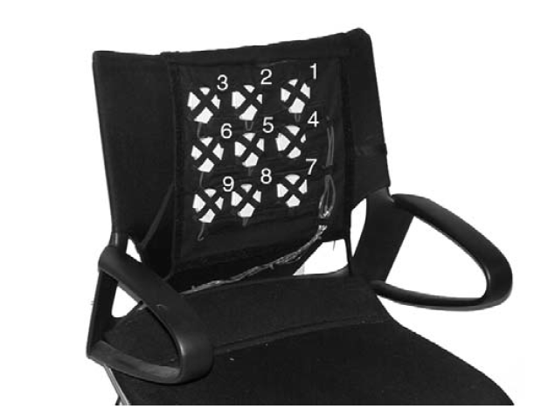
State Of The Art
1
Introduction
Guidance in drone teleoperation
→ Flyjacket
2
Development
[1]
Pattern transmission using tactile feedback
3
Experimental work
Various kinds of actuation
[1] Rognon et al. (2018), Haptic feedback perception and learning effect of a cable-driven guidance in the FlyJacket

Slide 4
State Of The Art
1
Introduction
Guidance in drone teleoperation
→ Flyjacket
2
Development
Pattern transmission using tactile feedback
3
Experimental work
[2]
Various kinds of actuation
[2] Sonar et al. (2016), Soft Pneumatic Actuator Skin with Piezoelectric Sensors for Vibrotactile Feedback
Notes:
Inside, take it off

Slide 5
State Of The Art
1
Introduction
Guidance in drone teleoperation
→ Flyjacket
2
Development
Pattern transmission using tactile feedback
3
Experimental work
[3]
[4]
Various kinds of actuation
[3] Novich et al. (2015), Using space and time to encode vibrotactile information: toward an estimate of the skin’s achievable throughput [4] Tan et al. (2003), A Haptic Back Display for Attentional and Directional Cueing

Slide 6
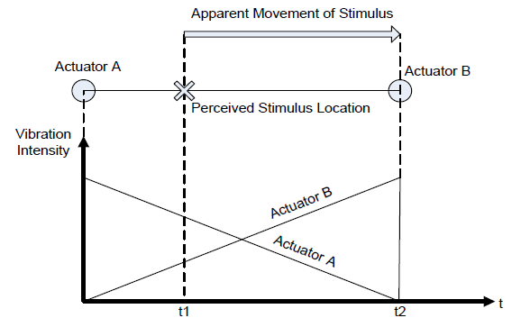
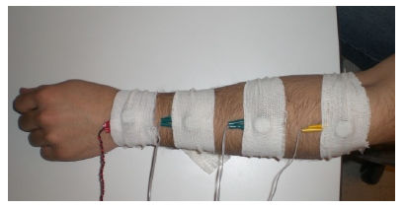
Funnelling Illusion
1
Introduction
Feeling of a continuous displacement
2
Development
3
Experimental work
[5]
[6]
[5] Cha et al. (2008), A pilot study on simulating continuous sensation with two vibrating motors [6] Barghout et al. (2009), Spatial resolution of vibrotactile perception on the human forearm when exploiting funneling illusion

Slide 7
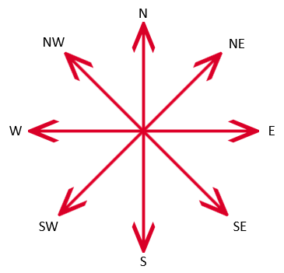
Approach
1
Introduction
3
Array of 3x3 vibrating motors
2
2
Development
1
8 different directions expressed
Applied on the back
3
Experimental work

Slide 8
Approach
1
Introduction
3
Array of 3x3 vibrating motors
2
2
Development
1
8 different directions expressed
Applied on the back
3
Experimental work

Slide 9
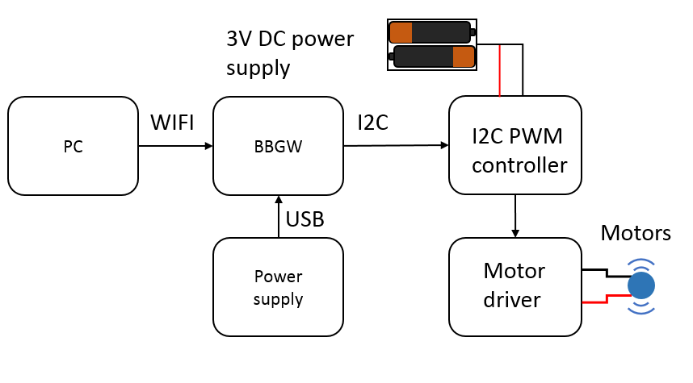
Prototype
1
Introduction
2
Development
3
Experimental work

Slide 10
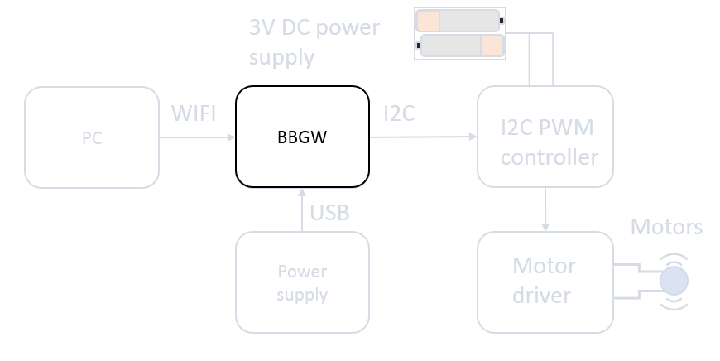
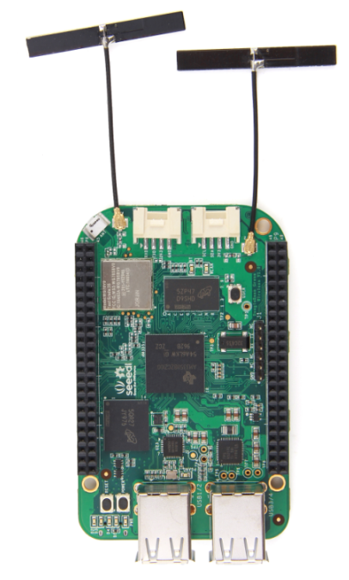
Prototype
1
Introduction
2
Development
3
Experimental work

Slide 11
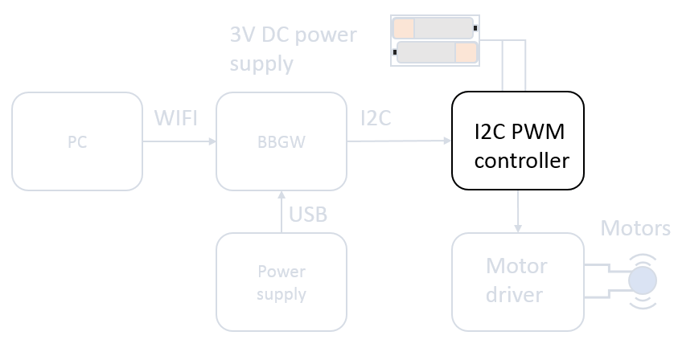
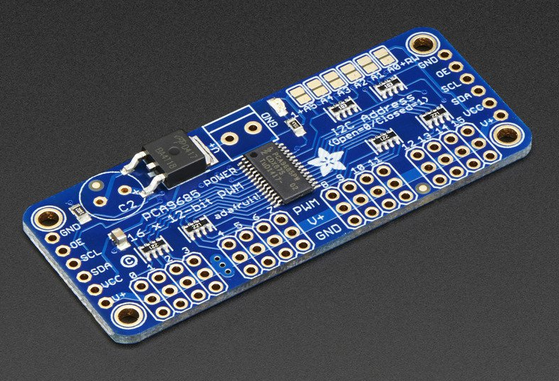
Prototype
1
Introduction
2
Development
3
Experimental work

Slide 12
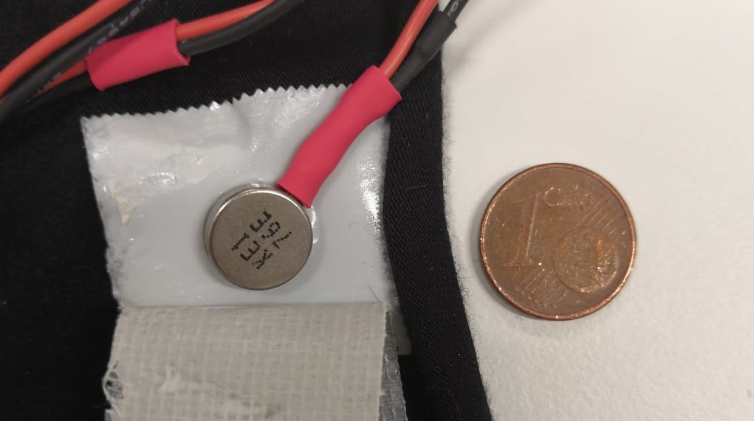
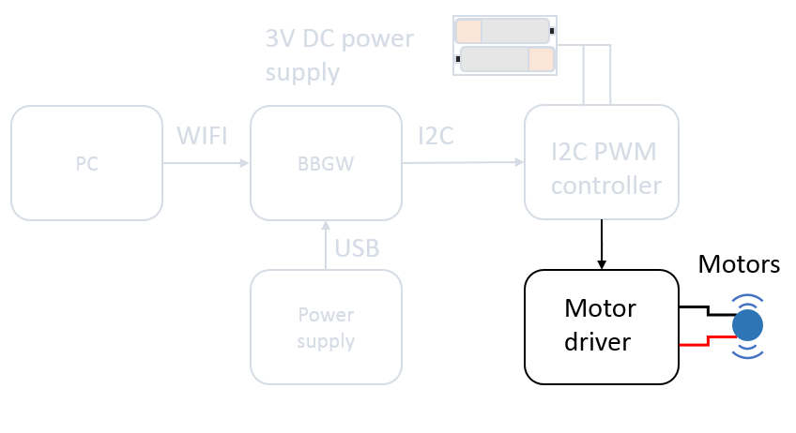
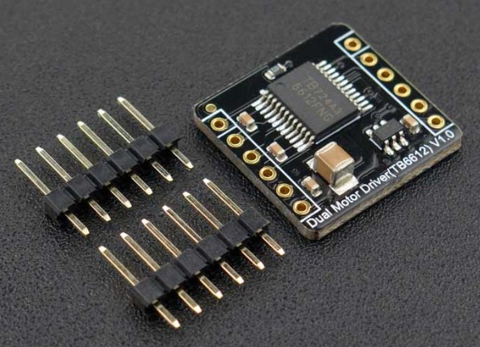
Motors and drivers
1
Introduction
2
Development
3
Experimental work

Slide 13
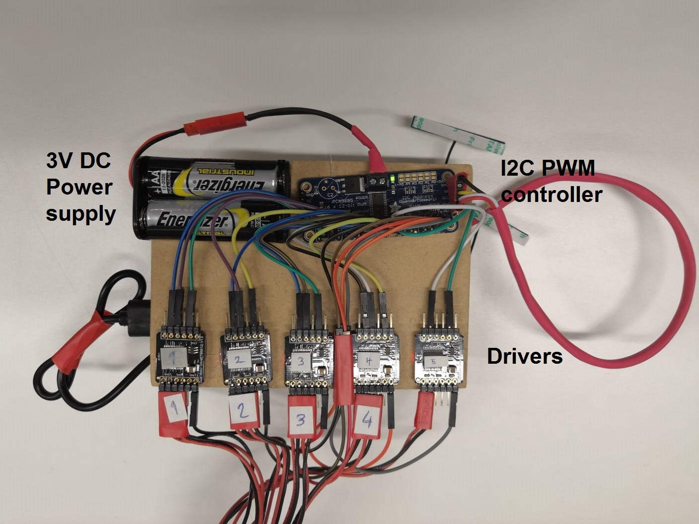
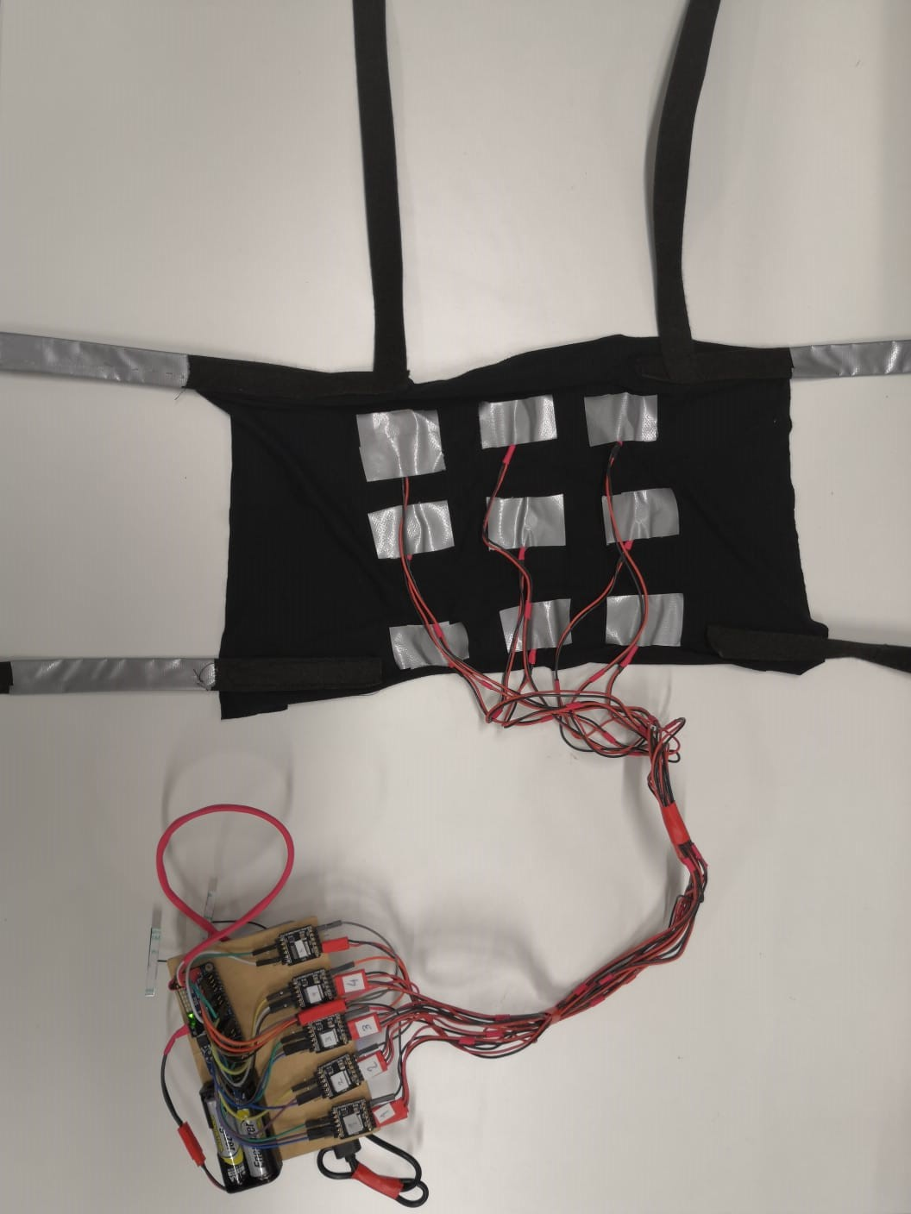
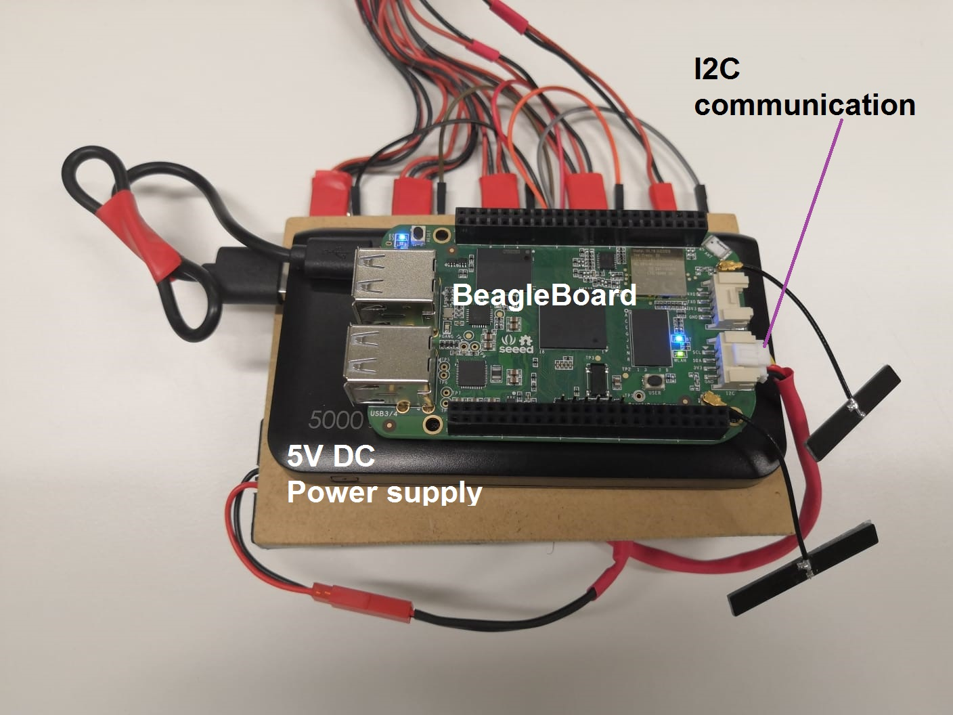
Prototype
1
Introduction
2
Development
3
Experimental work

Slide 14
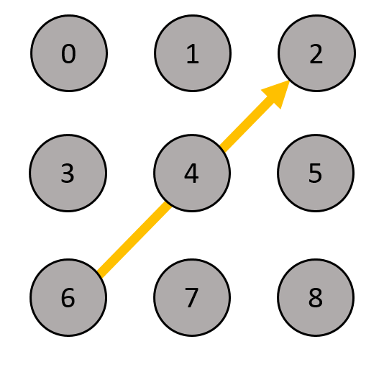
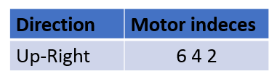


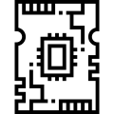
Control of the array (in Python)
1
Introduction
2
Development
3
Experimental work
Motor’s index
Switch corresponding motor on
Board receives message

Slide 15
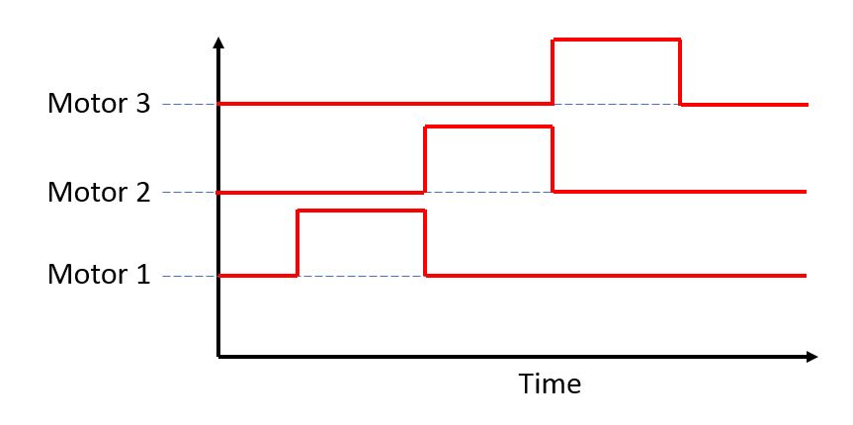
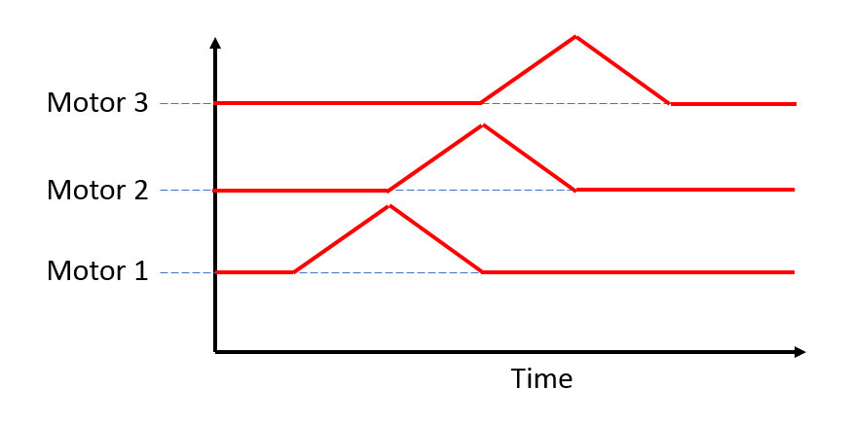
Experiment 1: direction
1
Introduction
Identification of direction cues
Step
2
Development
Linear
[5]
3
Experimental work
Question : which signal shape gives best results ?
[5] Cha et al. (2008), A pilot study on simulating continuous sensation with two vibrating motors

Slide 16
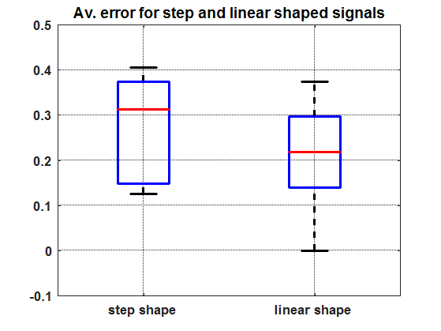
Experiment 1: results
1
Introduction
2
Development
3
Experimental work

Slide 17
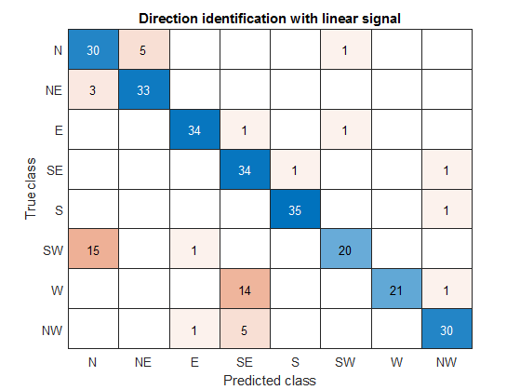
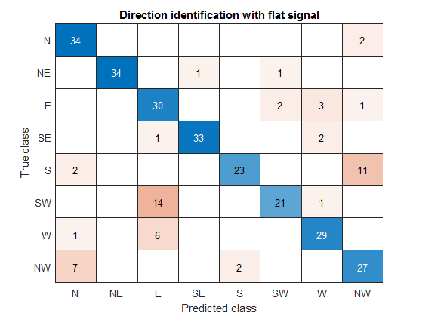
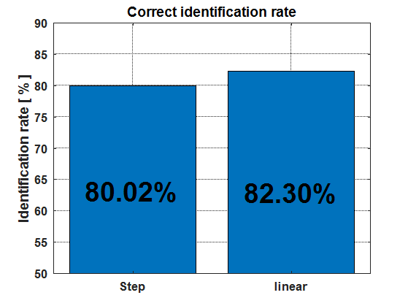
Experiment 1: results
1
Introduction
2
Development
3
Experimental work

Slide 18
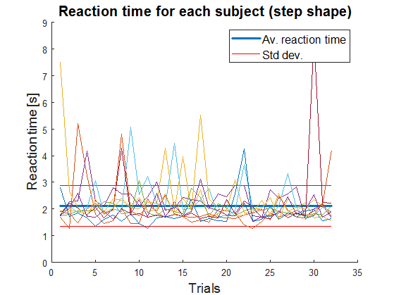
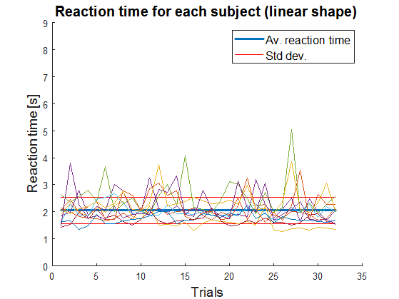
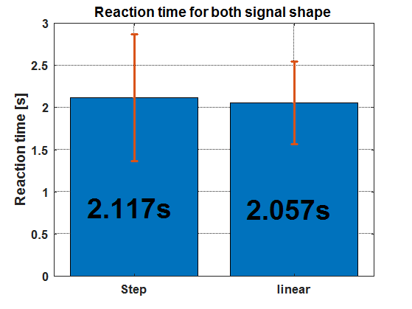
Experiment 1: results
1
Introduction
2
Development
3
Experimental work

Slide 19
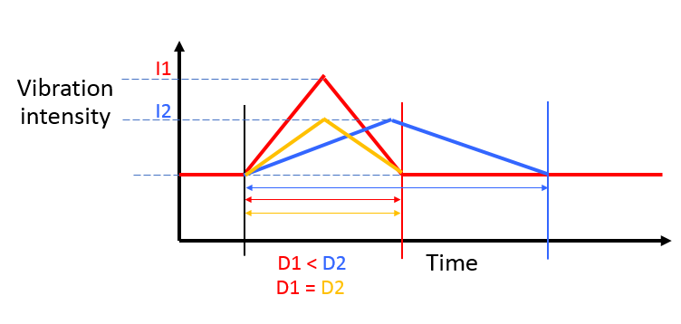
Experiment 2 : intensity
1
Introduction
Differentiation between different levels of intensity
2
Development
3
Experimental work
Notes:
Vibration intensity

Slide 20
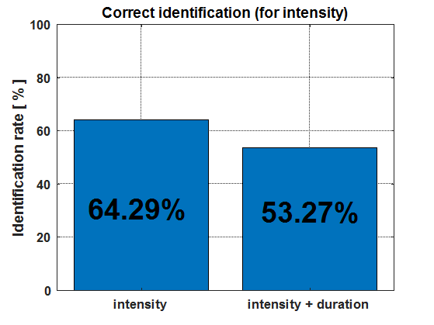
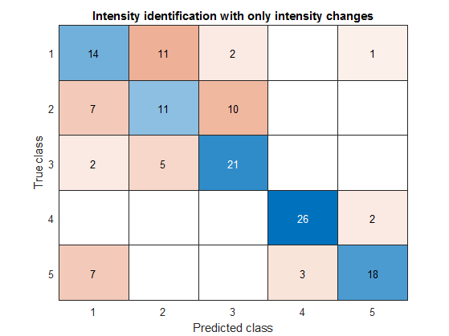
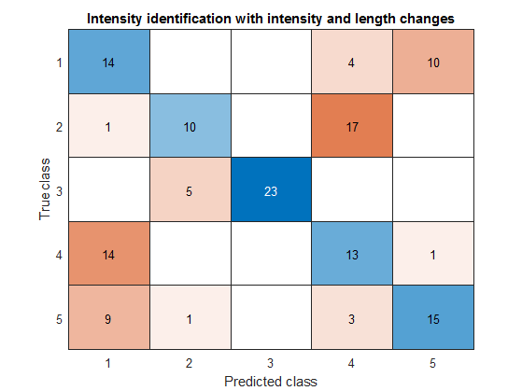
Experiment 2 : results
1
Introduction
2
Development
3
Experimental work

Slide 21
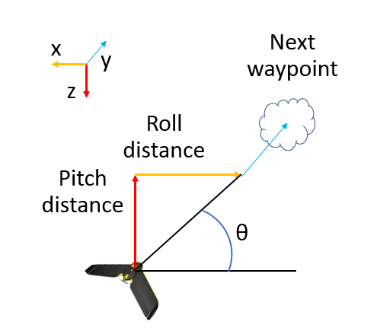
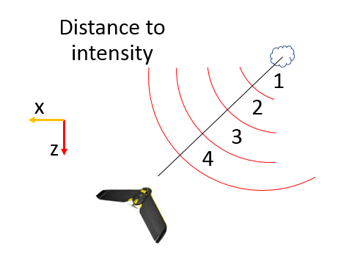
Experiment 3 : guidance
1
Introduction
Test the device on a flight simulator (FlyJacket model)
[7]
Data extracted :
2
Development
Direction and intensity
→ Vibrating pattern
Heading error
3
Experimental work
[7] Rognon et al. (2018), FlyJacket: An Upper Body Soft Exoskeleton for Immersive Drone Control

Slide 22
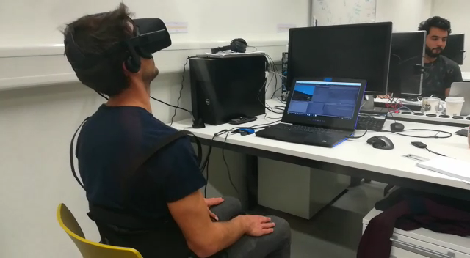
Experiment 3 : guidance
1
Introduction
2
Development
3
Experimental work

Slide 23
Experiment 3 : results
1
Introduction
2
Development
3
Experimental work
Notes:
Run number

Slide 24
Discussion
1
Introduction
Bugs during exp. 1 & 2
Few subjects
Problems :
2
Development
Obstacle avoidance
Change motor disposition
Saltatory phenomena
Future work :
3
Experimental work
Notes:
First goal : obstacle avoidance → a bit too much for this project, too ambitious

Slide 25
Discussion
1
Introduction
Bugs during exp. 1 & 2
Few subjects
Problems :
2
Development
Obstacle avoidance
Change motor disposition
Saltatory phenomena
Future work :
3
Experimental work
[4]
[4] Tan et al. (2003), A Haptic Back Display for Attentional and Directional Cueing

Slide 26
Conclusion
1
Introduction
Direction identification : 82.30% → comparable to existing devices
Intensity identification : 64.29% → needs to be improved
Best reaction time : 2.057 s → needs to be improved
[2,3]
2
Development
3
Experimental work
[3] Novich et al. (2015), Using space and time to encode vibrotactile information: toward an estimate of the skin’s achievable throughput [4] Tan et al. (2003), A Haptic Back Display for Attentional and Directional Cueing

Slide 27
Thanks for your attention
Any questions ?

Slide 28
References
[1] Rognon et al. (2018), Haptic feedback perception and learning effect of a cable-driven guidance in the FlyJacket
[2] Sonar et al. (2016), Soft Pneumatic Actuator Skin with Piezoelectric Sensors for Vibrotactile Feedback
[3] Novich et al. (2015), Using space and time to encode vibrotactile information: toward an estimate of the skin’s achievable throughput
[4] Tan et al. (2003), A Haptic Back Display for Attentional and Directional Cueing
[5] Cha et al. (2008), A pilot study on simulating continuous sensation with two vibrating motors
[6] Barghout et al. (2009), Spatial resolution of vibrotactile perception on the human forearm when exploiting funneling illusion
[7] Rognon et al. (2018), FlyJacket: An Upper Body Soft Exoskeleton for Immersive Drone Control
Notes:
Setup in extra slide

Slide 29
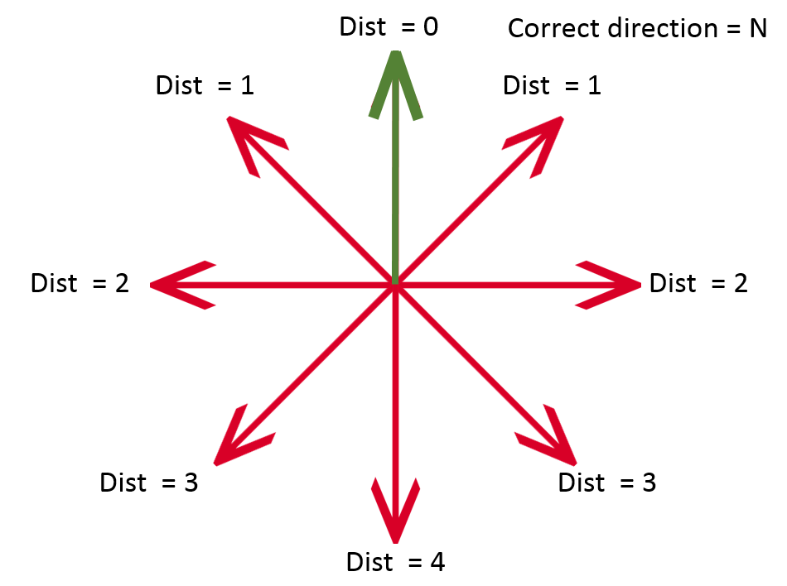
Annexe 1, error calculation
1
Introduction
2
Development
3
Experimental work
Notes:
Setup in extra slide

Slide 30
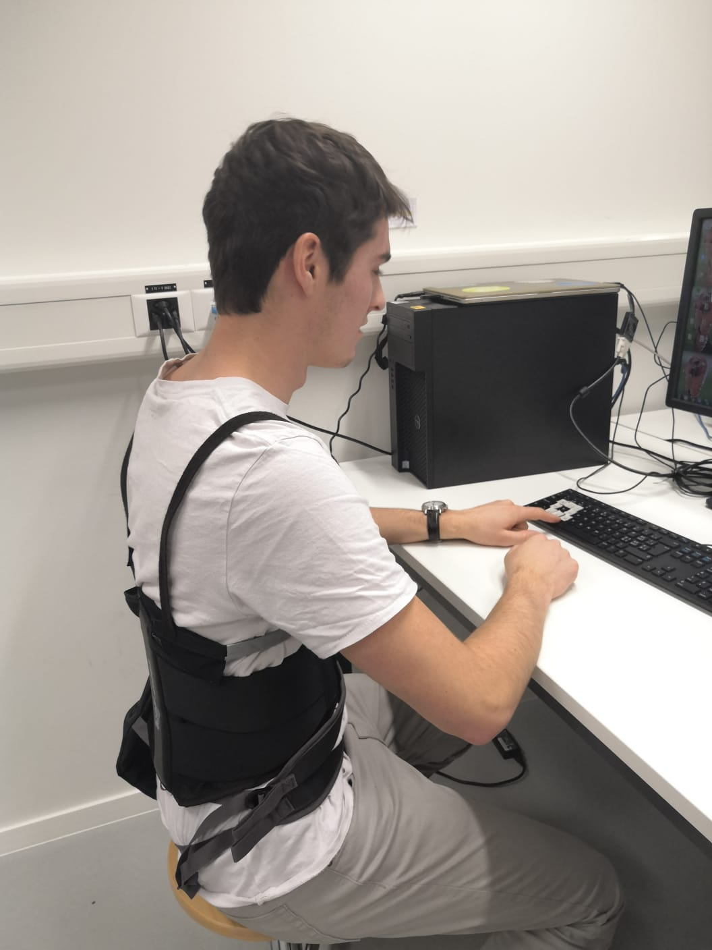
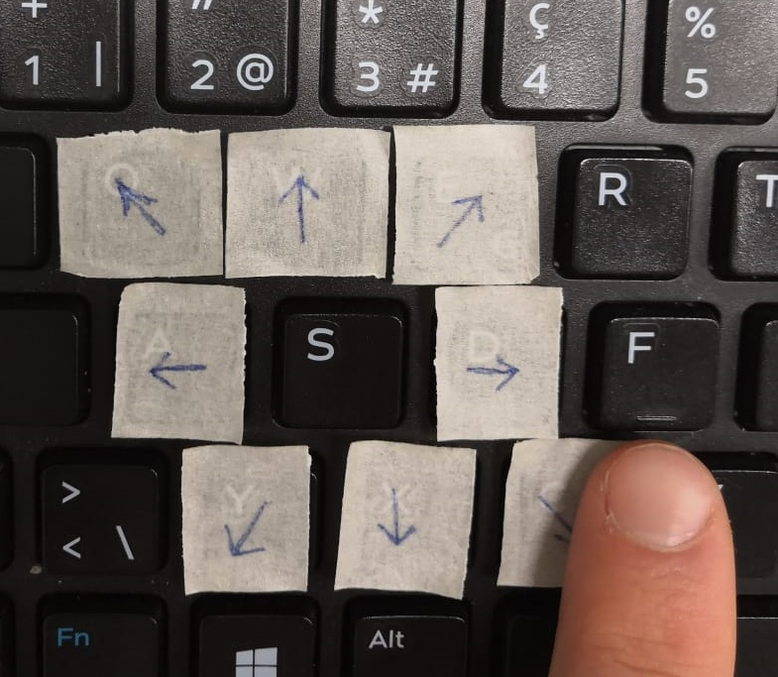
Annexe 2, set up experiment 1/2
1
Introduction
2
Development
3
Experimental work
Notes:
Setup in extra slide

Slide 31
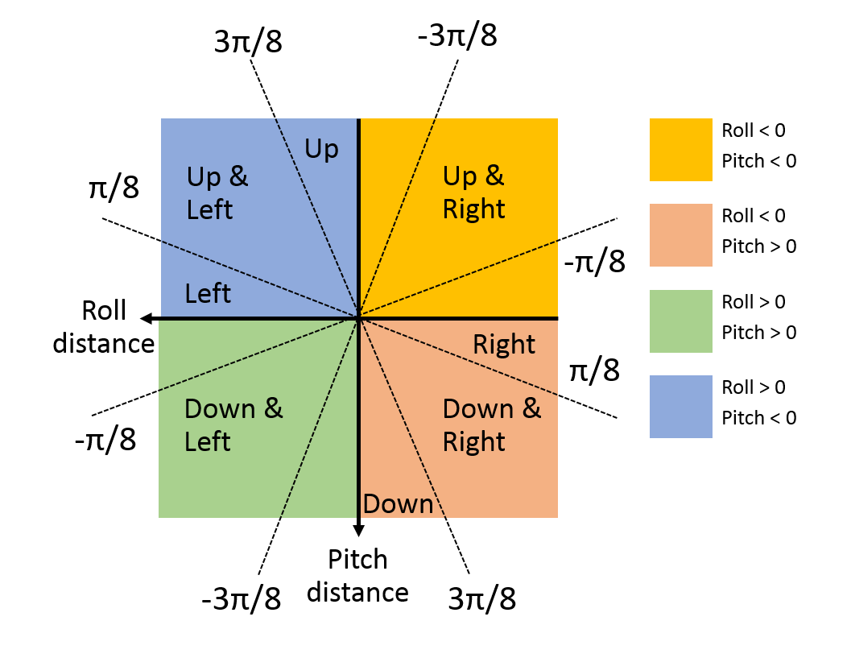
Annexe 3, experiment 3
1
Introduction
2
Development
3
Experimental work
Notes:
Setup in extra slide

